Slide 1
Investigating geothermal heat resources of legacy mine workings: Why are some mine waters hotter than others?
Mylene Receveur
Christopher McDermott, Stuart Gilfillan, Andrew Fraser-Harris

Slide 2
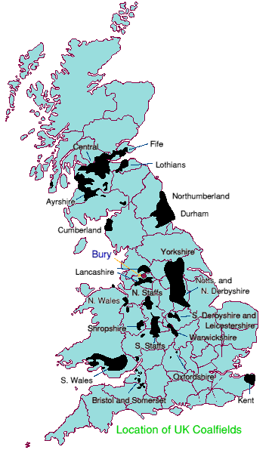
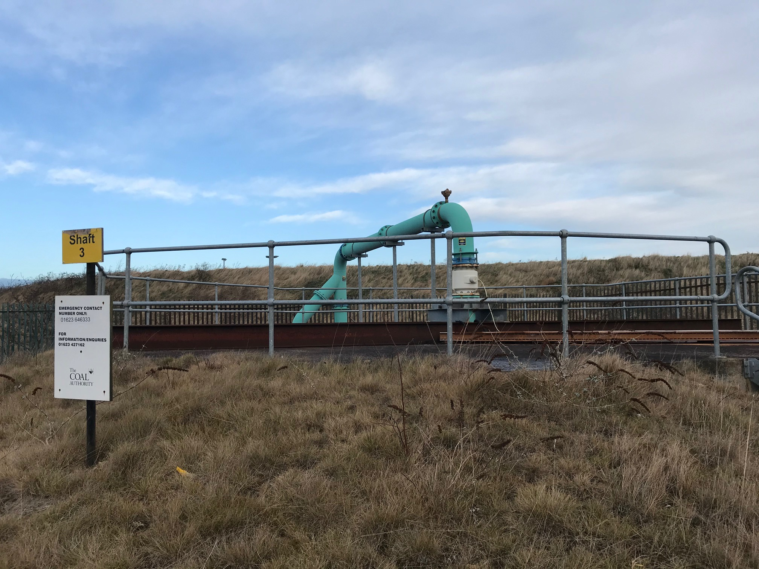
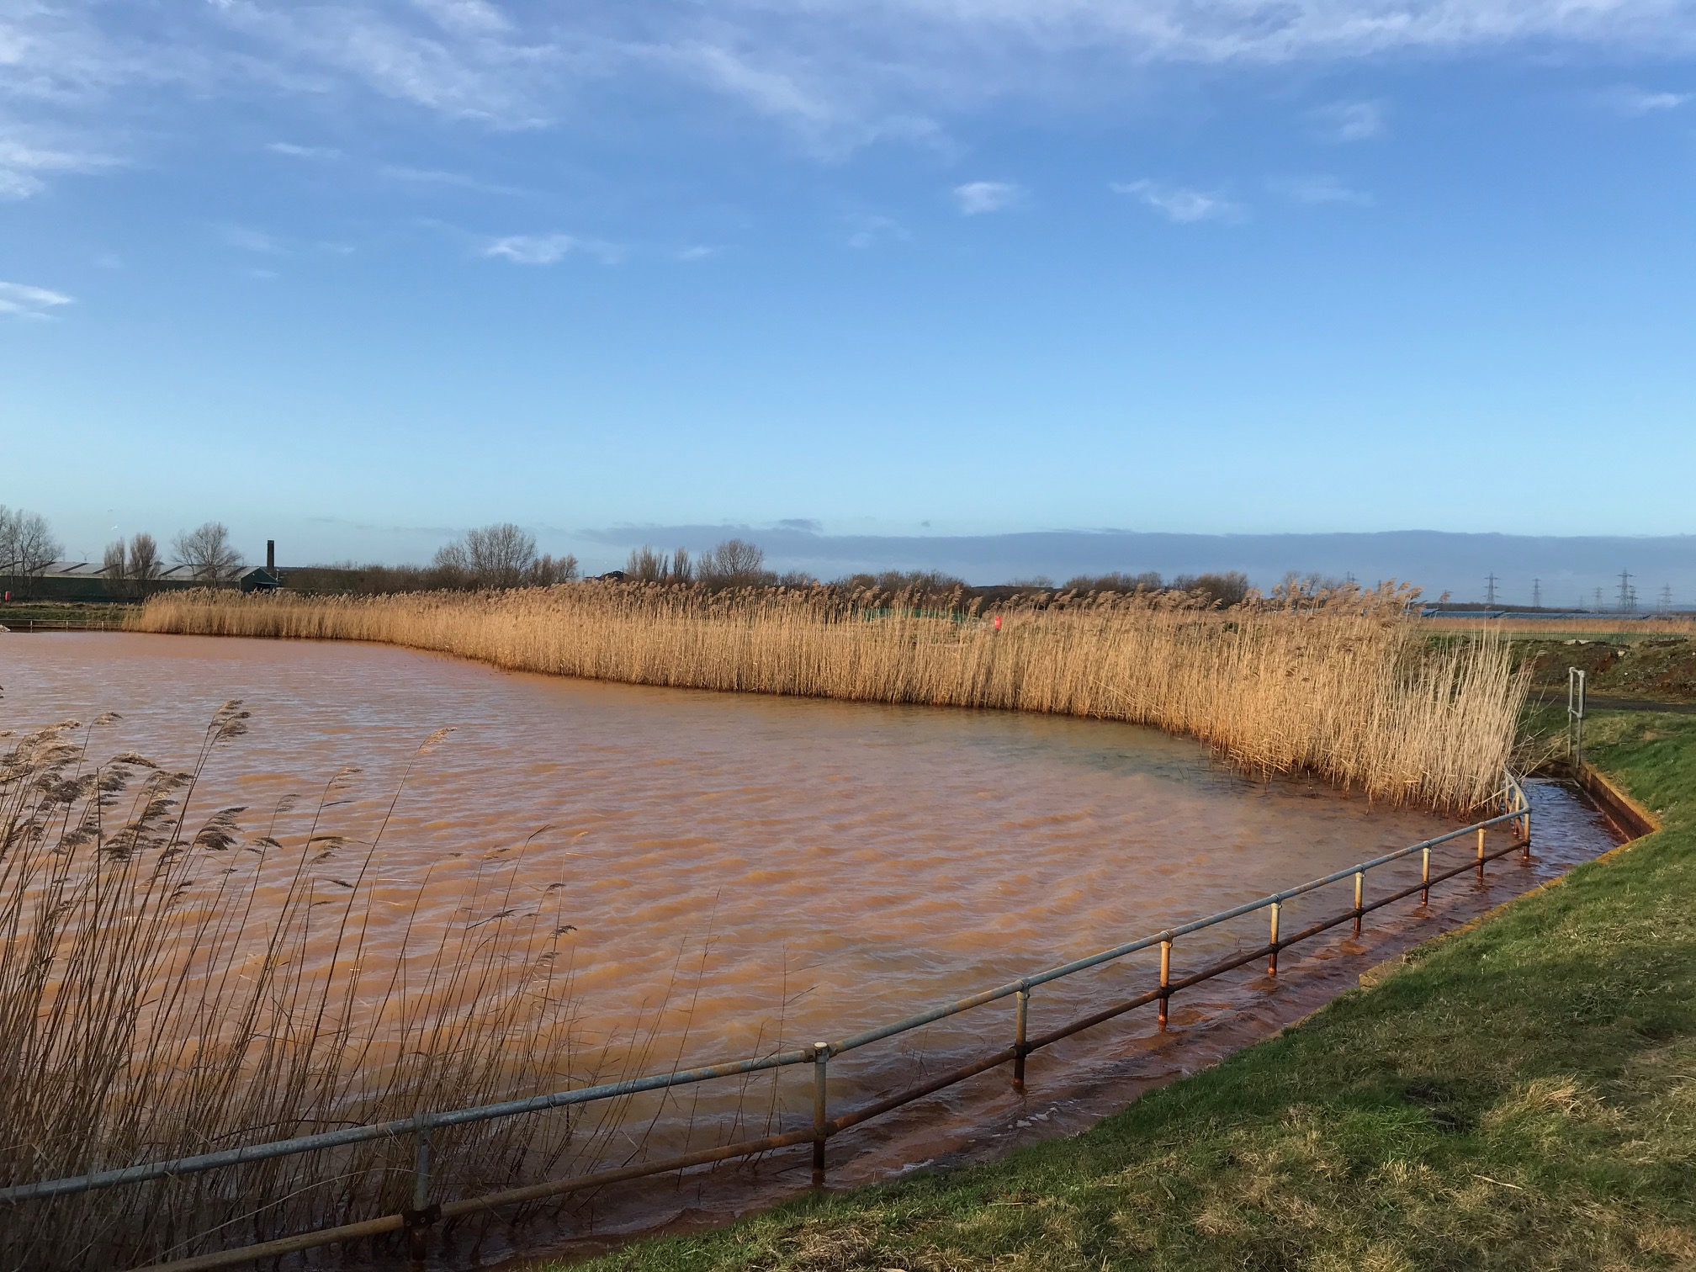
Study background
Introduction
Methods
Objectives
Conclusion
Summary
9% of UK population located above abandonned coal mines
Flooded mines: low-temperature geothermal resource (T= 12-20 °C)
7% of Scotland’s heat demand (Todd et al., 2019)
Can contribute to decarbonization of residential heat
Coal Authority liable for UK mines legacy

Slide 3
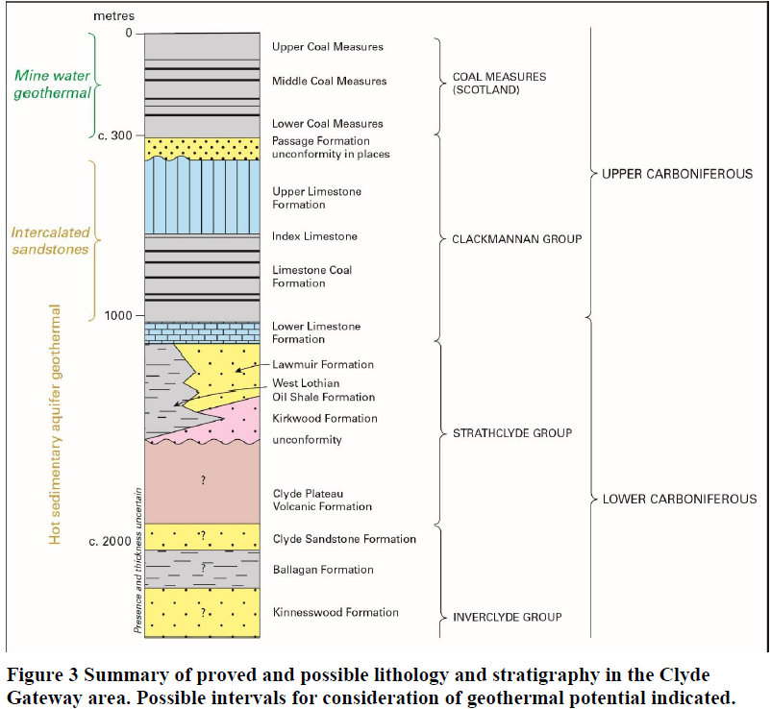
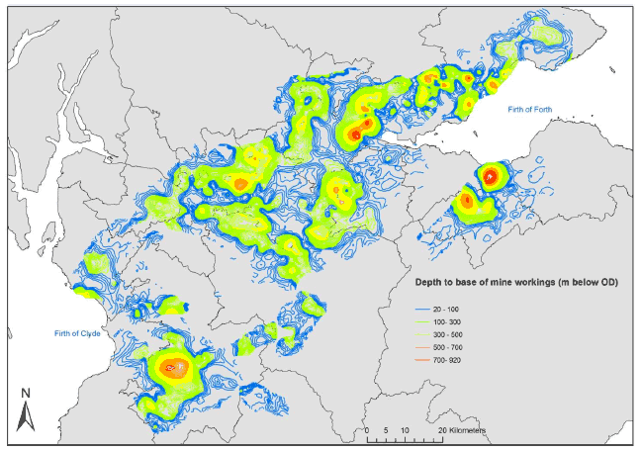
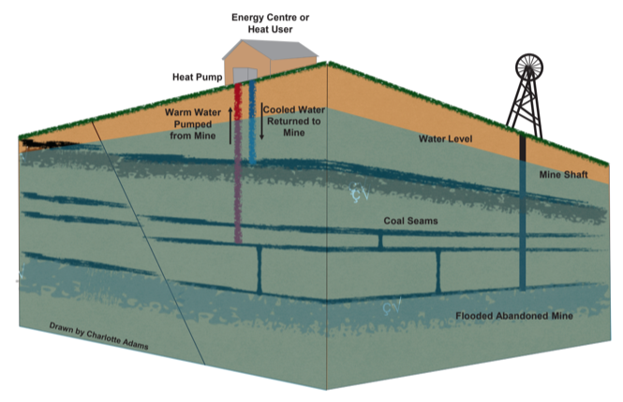
Mine-water Heat: Resource definition
Introduction
Methods
Objectives
Conclusion
Summary
Coal Measures
Large mining voids gets flooding when mining stops
Open-loop GSHP systems.
High pumping rate
Seasonal production
Existing case study: UK (Shettleston, Dawdon), Spain, Canada, USA, Poland, The Netherlands (Heerlen)
Limestone Coal formation
Schematic diagram of a mine water heat pump system (Charlotte Adams)
Depth of mine workings (Gillespie et al., 2013)
Notes:
Warm water can be extracted at high rates from enhanced-permeability reservoirs
GSHP used to extract heat from the ground or from the water using open-loop systems.
Injection/production of cold/hot water can be reversed seasonally
Existing case study: Germany, Canada, USA, UK (Shettleston, Dawdon, Markham), Poland, The Netherlands, Spain
At Heerlen, abandoned mines are used to deliver space heating and cooling to around 200,000 m2 of mixed use new and retrofit buildings via a 7-km-long heat network (Verhoeven et al., Energy Procedia 2014).
Two permanent open loop mine water-based ground source heating schemes commissioned in 1999-2000 in Shettleston (used to heat to 16 dwellings over an area of 1600 m² near Glasgow) and in Lumphinnans, near Cowdenbeath in Fife (Banks et al., 2009). There, 12°C and 14.5°C water is pumped at a rate of 5-10 l/s from about 100 and 172 m, respectively. The water circulates through the heat pump before being reinjected at a temperature of 3°C in the Carboniferous strata, via 50 and 60 m deep boreholes located 20 and 100 m away from the production ones (Banks et al., 2004). The table below summarizes the mine-water projects listed in the UK.
In Shettleston, where at least 6 seams have been mined, the water is heated to 55°C through a heat exchanger, to provide heat to 16 dwellings. In Lumphinnans, at least 11 seams belonging to the Lower Carboniferous Limestone Coal Group have been mined (including the uppermost Lochgelly Black Band Ironstone, the Seven Foot Seam, the Kelty Main, the Jersey or Diamond Seam and the Swallowdrum (Burke 1999)).

Slide 4
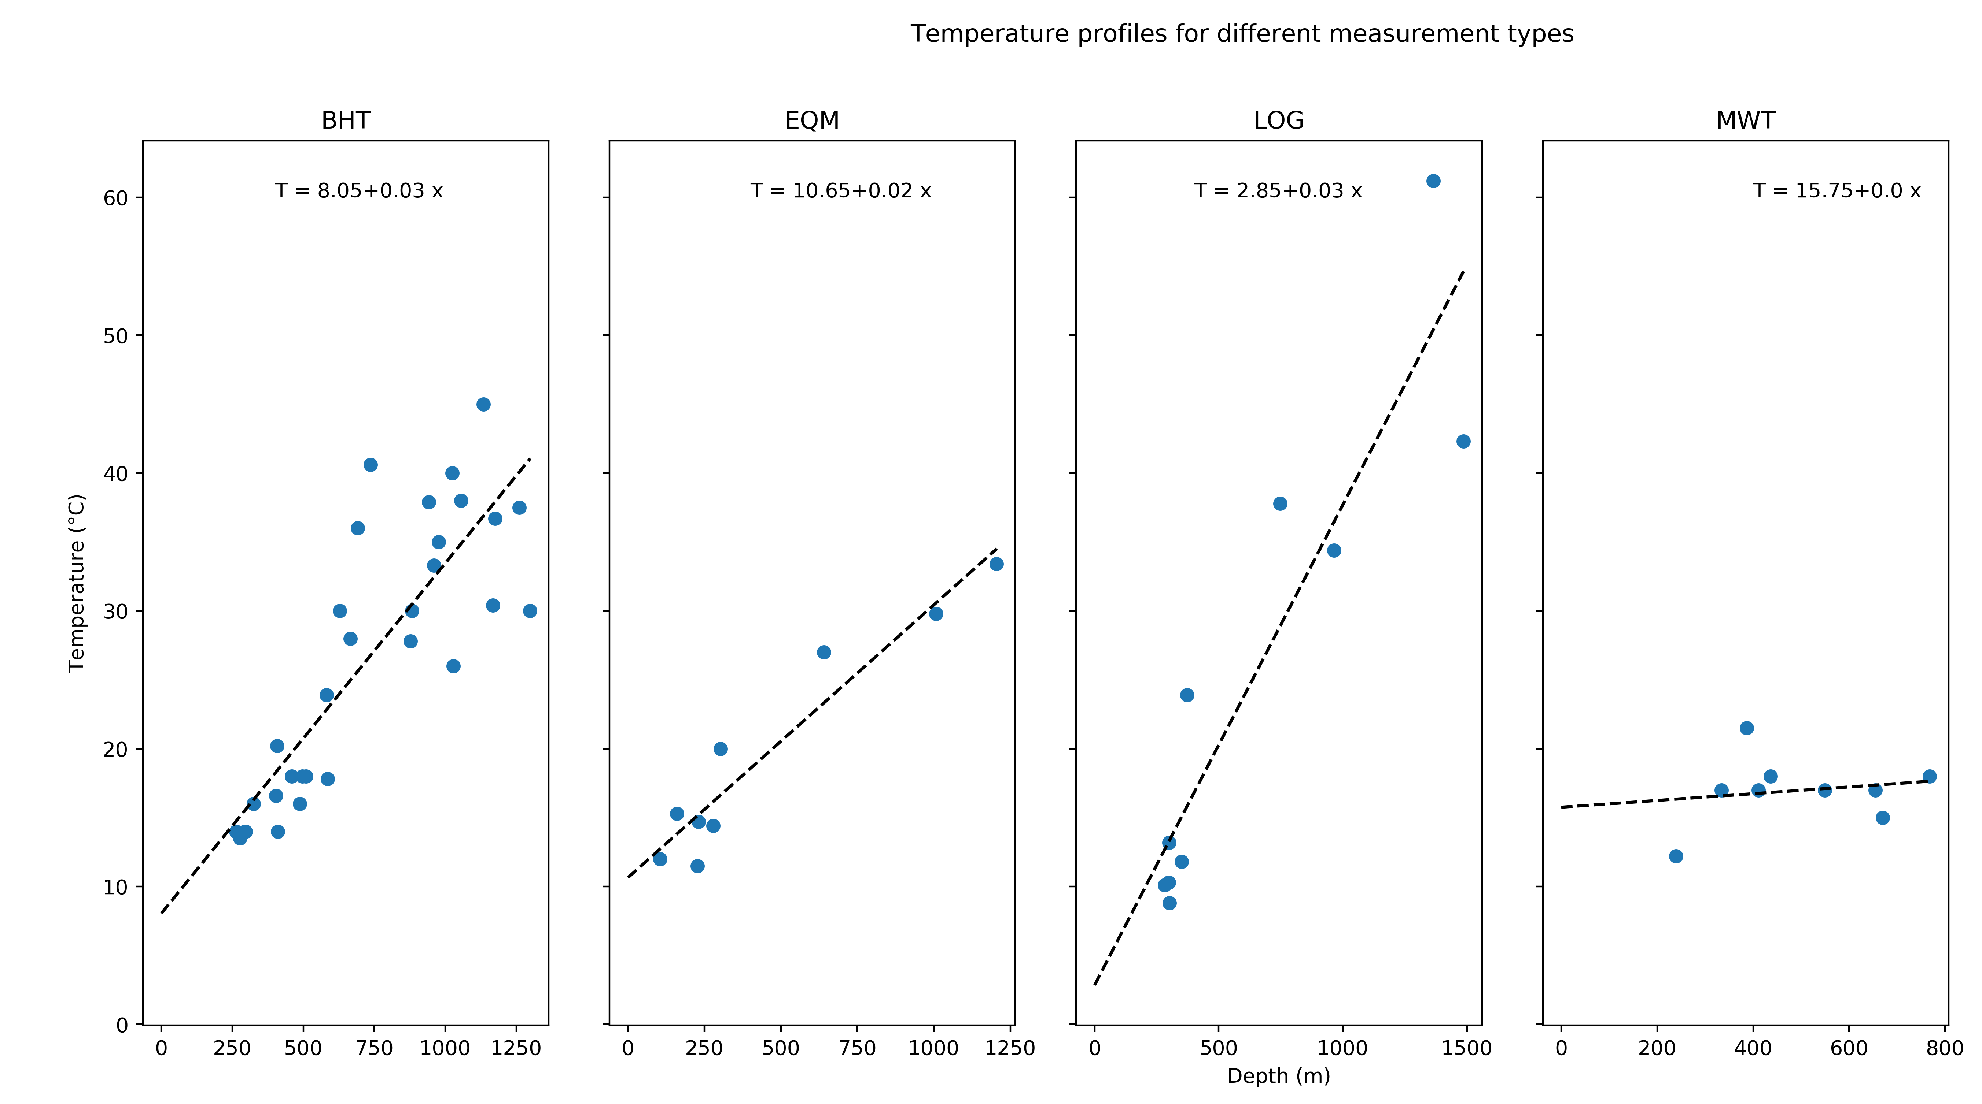
Research question
Introduction
Methods
Objectives
Conclusion
Summary
??
Burley, 1984
What are the main controls on mine water temperature ?
Necessary to evaluate the geothermal potential of coal mines.
Notes:
Poor understanding of the origin of heat in mines: issue to evaluate the geothermal potential
No clear correlation of temperature with depth (Gillespie et al., 2013)
Extracting water can induce inflow of recharge water (from infiltration, lateral aquifers), or re-injection can be performed.
Need to know what are the heat recharge mechanisms, the rate heat recovery and the area impacted by heat extraction, to ensure sustainable production

Slide 5
Summary
Introduction
Methods
Objectives
Conclusion
Summary
Research objectives
Methods
Deliverables

Slide 6
Objective 3 Objective 2 Objective 1
Introduction
Methods
Objectives
Conclusion
Summary
Determine the main heat sources and heat transfer mechanisms in flooded coal mines
What is the heat recovery rate of water in coal mines?

Slide 7
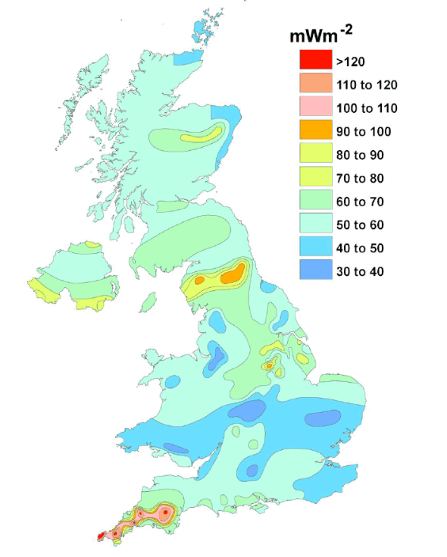
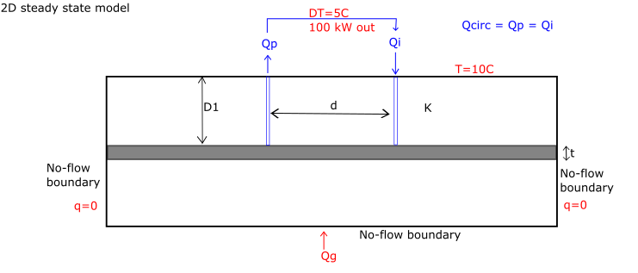
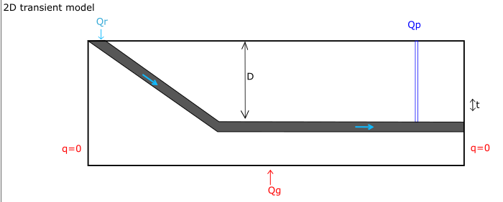
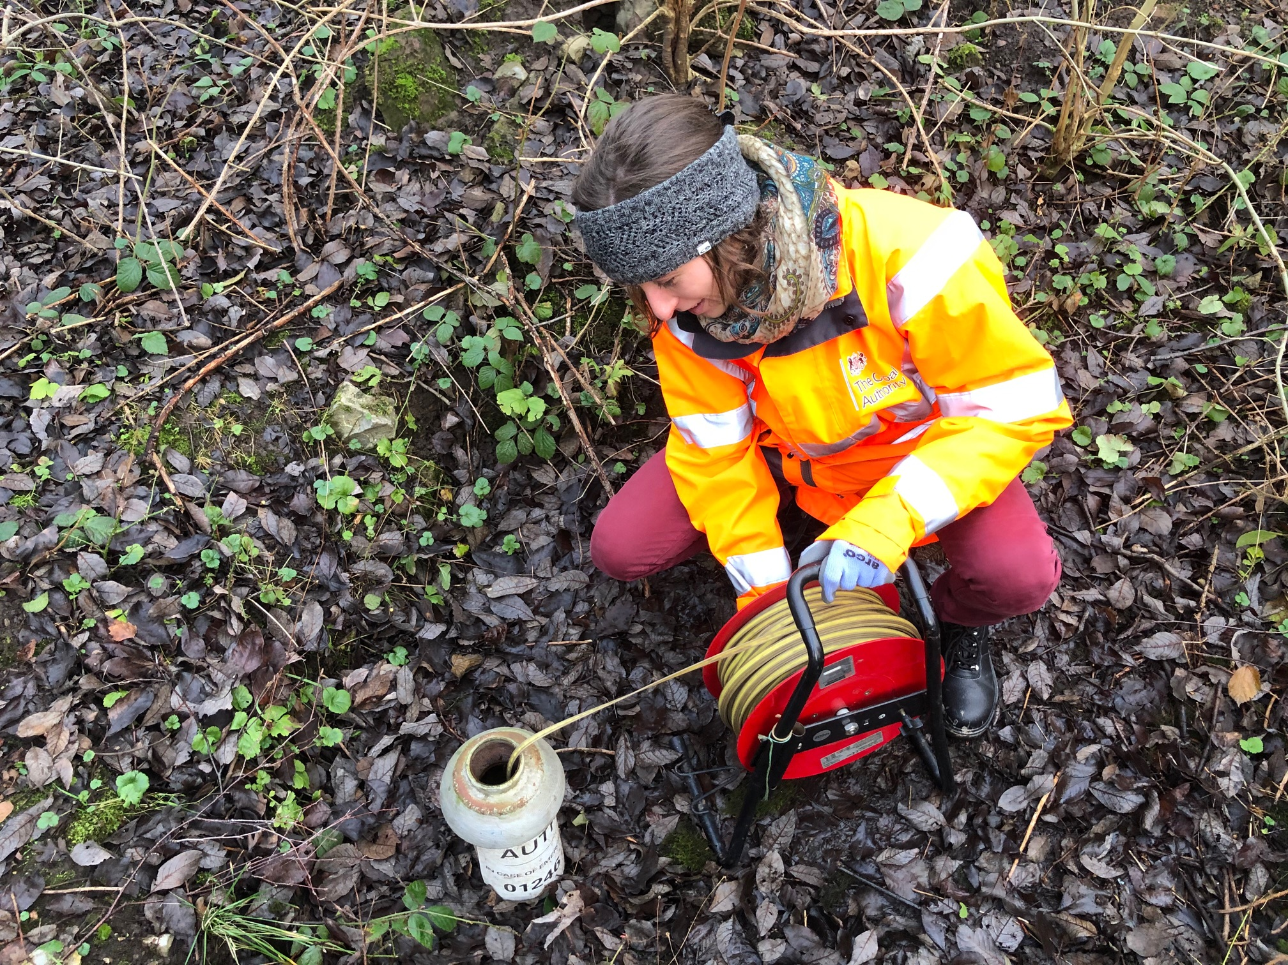
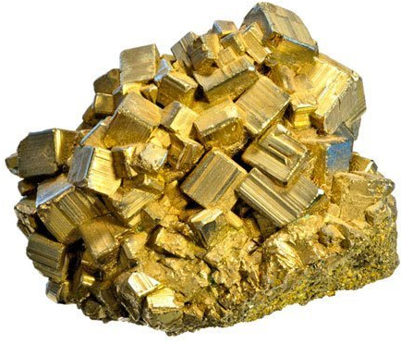
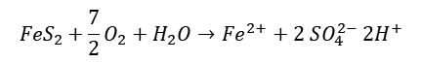
Introduction
Methods
Objectives
Conclusion
Summary
Data inventories
Spatial analysis of temperature distribution in the UK
Conceptual models
Potential source of heat
natural heat flow
local heat generation
solar influx
groundwater flow
rainfall
geological structure
Solar flux
Rainfall
$${FeS}_{2}+\frac{7}{2}O_{2}+H_{2}O→{Fe}^{2+}+2 {SO}_{4}^{2−} {2H}^{+}$$
Notes:
Data inventory made: Mine temperature profiles/time-series will be compared to geological, climatic conditions in Scotland and in the UK
Water level = logger and on site measurements
Temperature: Logger temperature and on-site measurements (Temperature versus time)
+ Temperature and conductivity logs
Geochemistry: Deep water in Dawdon (Chloride anion dominant = long residence time) while shallow water in Bilston Glen (Bicarbonate dominant) according to Chebotarev chart
Issue with loggers: no information about the depth of the sensor, but can inform on seasonal changes in temperature
2D models based on conceptual/simple mine geometry
Local heat generation : radiactive decay, pyrite oxidation
Groundwater flow = convective flux
geological structure: geological formation with specific material, thermal and hydraulic properties; geological disturbances (i.e. faults)

Slide 8
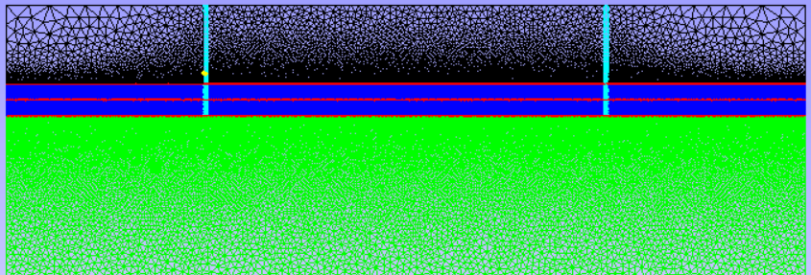
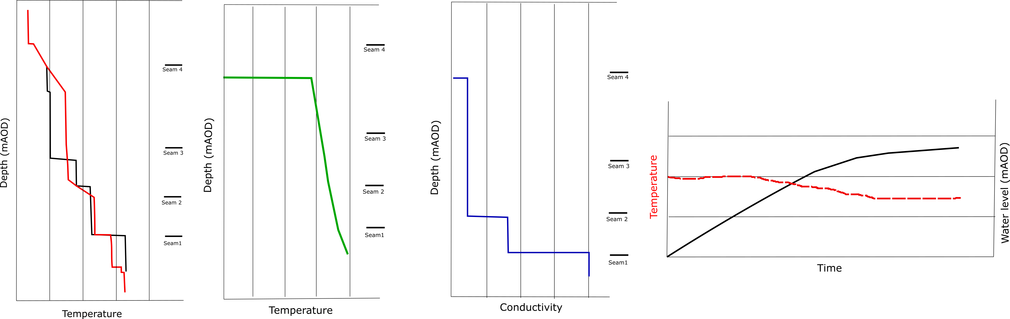
Introduction
Methods
Objectives
Conclusion
Summary
Numerical simulation using OpenGeosys
Petrophysical + Hydraulic / thermal properties
for each material
Initial /boundary conditions
Source terms
Sensitivity analysis on model parameters
Calibration / validation using existing data:
EC-T profiles
Water level and temperature time series
Notes:
OGS: open source FEM software
2) Sensitivity analysis on geometrical, technical or numerical parameters: Simulation of cold water injection/recharge will allow determining, through sensitivity analysis, the parameters the more likely to influence mine water temperature.
3) Based on calibrated model, evaluation of the recharge rate / heat recovery rate of mine water. How long can it be sustained? what is the footprint area for providing heat for domestic heating?

Slide 9
Objective 3 Objective 2 Objective 1
Introduction
Methods
Objectives
Conclusion
Summary
Determine the main heat sources and heat transfer mechanisms in flooded coal mines
What is the heat recovery rate of water in coal mines?
Assess the important geometrical features in mine plans for modelling.
How can representative simplification of mine plans be made?

Slide 10
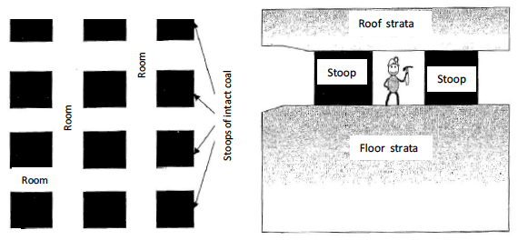
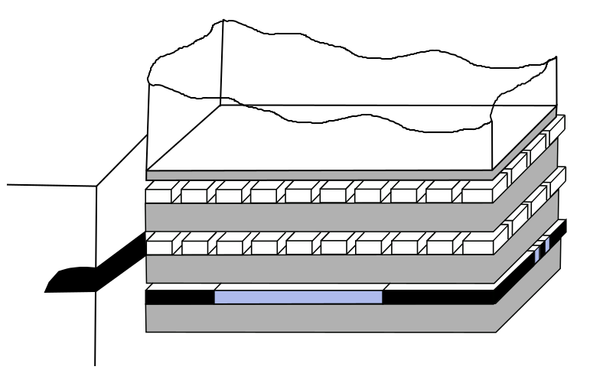
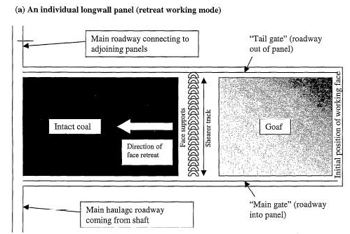
Introduction
Methods
Objectives
Conclusion
Summary
Mine structure
Underground workings:
Pillar and stall
Longwall mining
Main pathways :
Shafts
Roadways
Mine plans:
Rationalized
Digitalized
GIS shapefiles
Statistical distribution of the mine voids
How can we simplify mine plans to build representative models, using digitalized data ?
Numerical simulations
Layout of stoop and room mine workings (top) and longwall mining (bottom). From Younger and Adams, 1999.
Notes:
A series of model will be created through the development of a methodology to generate a representative statistical distribution of mine working network / roadways. Calibration and validation of model using existing data (i.e. simulation of flooding, flow rate, temperature profile).

Slide 11
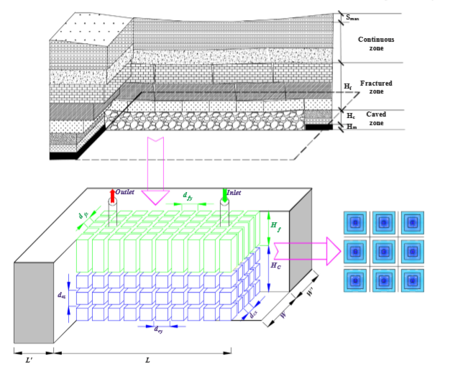
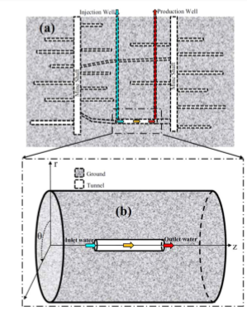
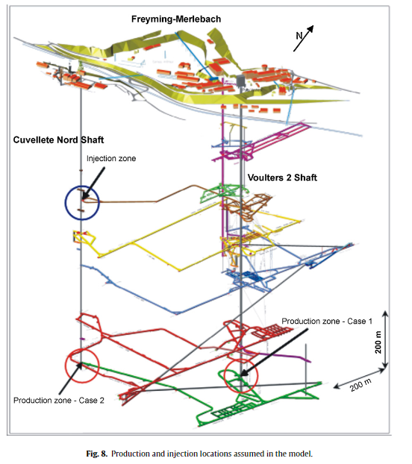
Introduction
Methods
Objectives
Conclusion
Summary
Modeling approches in the literature
Dual-porosity medium (Guo at al., 2018)
Heat transfer in mine tunnels
Ghoreishi Madeish et al. (2012)
3D model of shaft/roadway connections
(Hamm et al., 2010)
Combined 3D porous medium and 1D pipe flow
(Raymond and Therrien, 2008; Renze et al., 2009)
Notes:
Difficulty in mine systems (which differs from usual aquifers) is the necessity to solve for water, heat and mass transport in a system composed of a porous media (Darcy flow) and open void (pipe flow) that can lead to numerical instability.

Slide 12
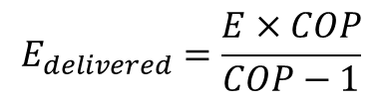
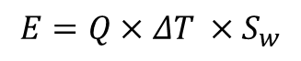
Objective 3 Objective 2 Objective 1
Introduction
Methods
Objectives
Conclusion
Summary
Determine the main heat sources and heat transfer mechanisms in flooded coal mines
What is the heat recovery rate of water in coal mines?
Assess the important geometrical features in mine plans for modelling.
How can representative simplification of mine plans be made?
Evaluate the footprint area of heat extraction
What is the geothermal potential of mines?
Can a sustainable heat extraction rate be maintained?
$$E=Q×ΔT ×S_{w}$$
$$E_{delivered}=\frac{E×COP}{COP−1}$$

Slide 13
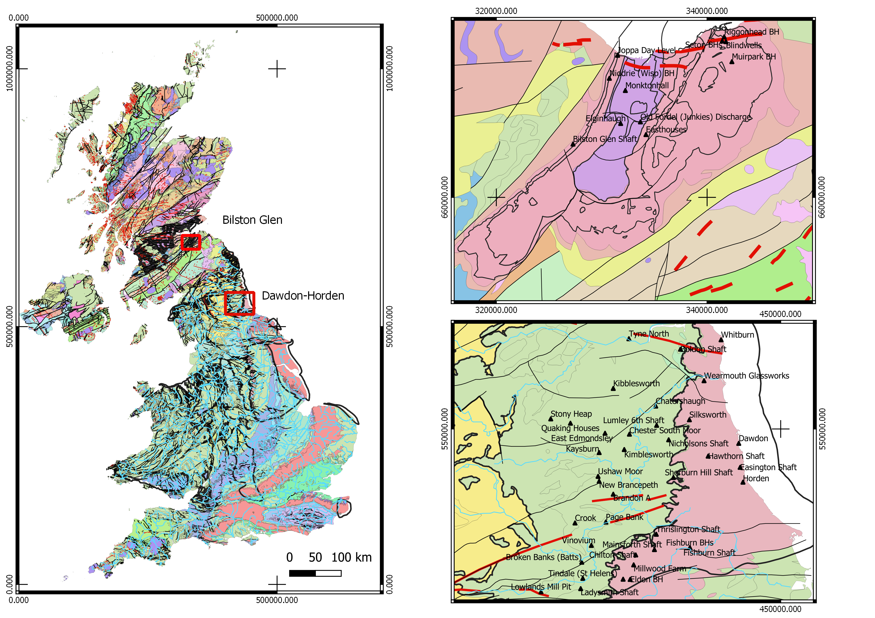
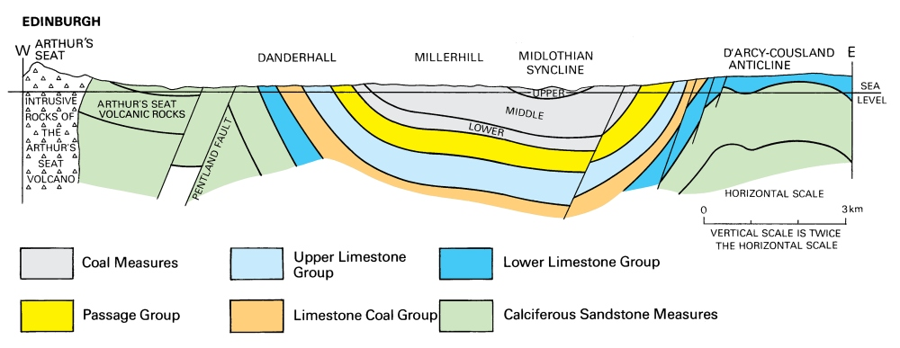
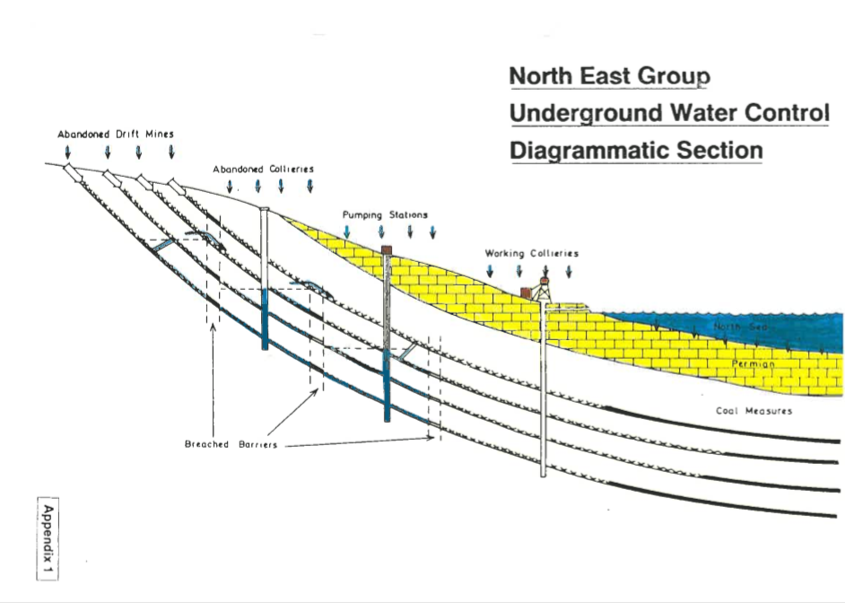
Introduction
Methods
Objectives
Conclusion
Summary
2 Case study : and Bilston Glen (Scotland)
Cross-section of the Midlothian syncline. From: Figure 38. Cameron, I B, and Stephenson, D. 1985. British regional geology: The Midland Valley of Scotland. Third edition. Reprint 2014. Keyworth, Nottingham: British Geological Survey.
Notes:
The research will involve numerical modelling of mines, calibrated and validated using real data from 2 different areas:
Bilston Glen in Scotland
Dawdon in NE England
→ Enough data to calibrate the models and different geometries

Slide 14
Introduction
Methods
Objectives
Conclusion
Summary
Development of a predictive (conceptual or numerical) tool.
Recommendation on a scientific approach to guide the licensing of heat
Support the dimensioning of GSHP systems

Slide 15
References
Gillespie, M., Crane, E., and Barron, H. (2013). Study into the Potential for Deep Geothermal Energy in Scotland - Volume 2. AEC/001/11. Scottish Government, p. 129.
Todd, F., McDermott, C., Harris, A. F., Bond, A., and Gilfillan, S. (2019). Coupled hydraulic and mechanical model of surface uplift due to mine water rebound: implications for mine water heating and cooling schemes. Scottish Journal of Geology [online], sjg2018–028. ISSN: 0036-9276, 2041-4951. DOI: 10.1144/sjg2018-028.

